Slide 1


ASSERT: A Software Suite for Earth-systems Regression Testing Summer 2023 Internship
Deon Kouatchou
Notes:
Deon Kouatchou
Rising Sophomore
Computer Science
Carnegie Mellon University
Worked on ASSSERT

Slide 2

Background

Slide 3
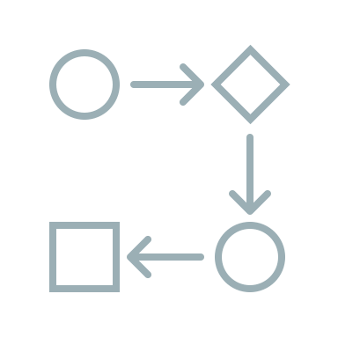
Regression Testing
Old commit
New changes
Regression testing is a technique that tests software functionality after code updates. It ensures that previously developed and tested software still performs as expected.
Testing plays a crucial role for scientists working with Earth-systems models. For example, if a new commit is made to the model, various tests are run to ensure the new version of the model is still functional.
Finalized new commit
Testing
Notes:
Regression testing is a software technique that ensures functionality after code changes by extensive testing.
Regression testing is especially important for Earth-systems models as scientists and software developers may adjust them over time.

Slide 4





About ASSERT
Currently, many earth-systems models have their own independent testing tools.
ASSERT is a centralized, Python-based regression testing toolkit that aims to allow users to build regression testing workflows for numerous earth-systems models.
Key features:
Test case management
Configuration using YAML files
Compatibility with Git repositories
Report generation
Easy integration of new models
Notes:
Currently, many of these models have their own independent regression testing software and many are Python-based.
Thus, ASSERT, which is also Python-based, aims to centralize testing for ESM.
Some key features are...

Slide 5


Project Responsibilities
When joining this project, though there was a lot of thorough effort put towards establishing documentation, Gitlab management, and prospective designs for ASSERT.
My primary responsibility was implementing the code infrastructure.
Notes:
In beginning this project, there was an emphasis of creating a strong starting foundation for ASSERT which included Gitlab management, requirements documents, and more.
My primary objective was to now establish the code infrastructure which is what the next few sections will cover.

Slide 6

Infrastructure I

Slide 7
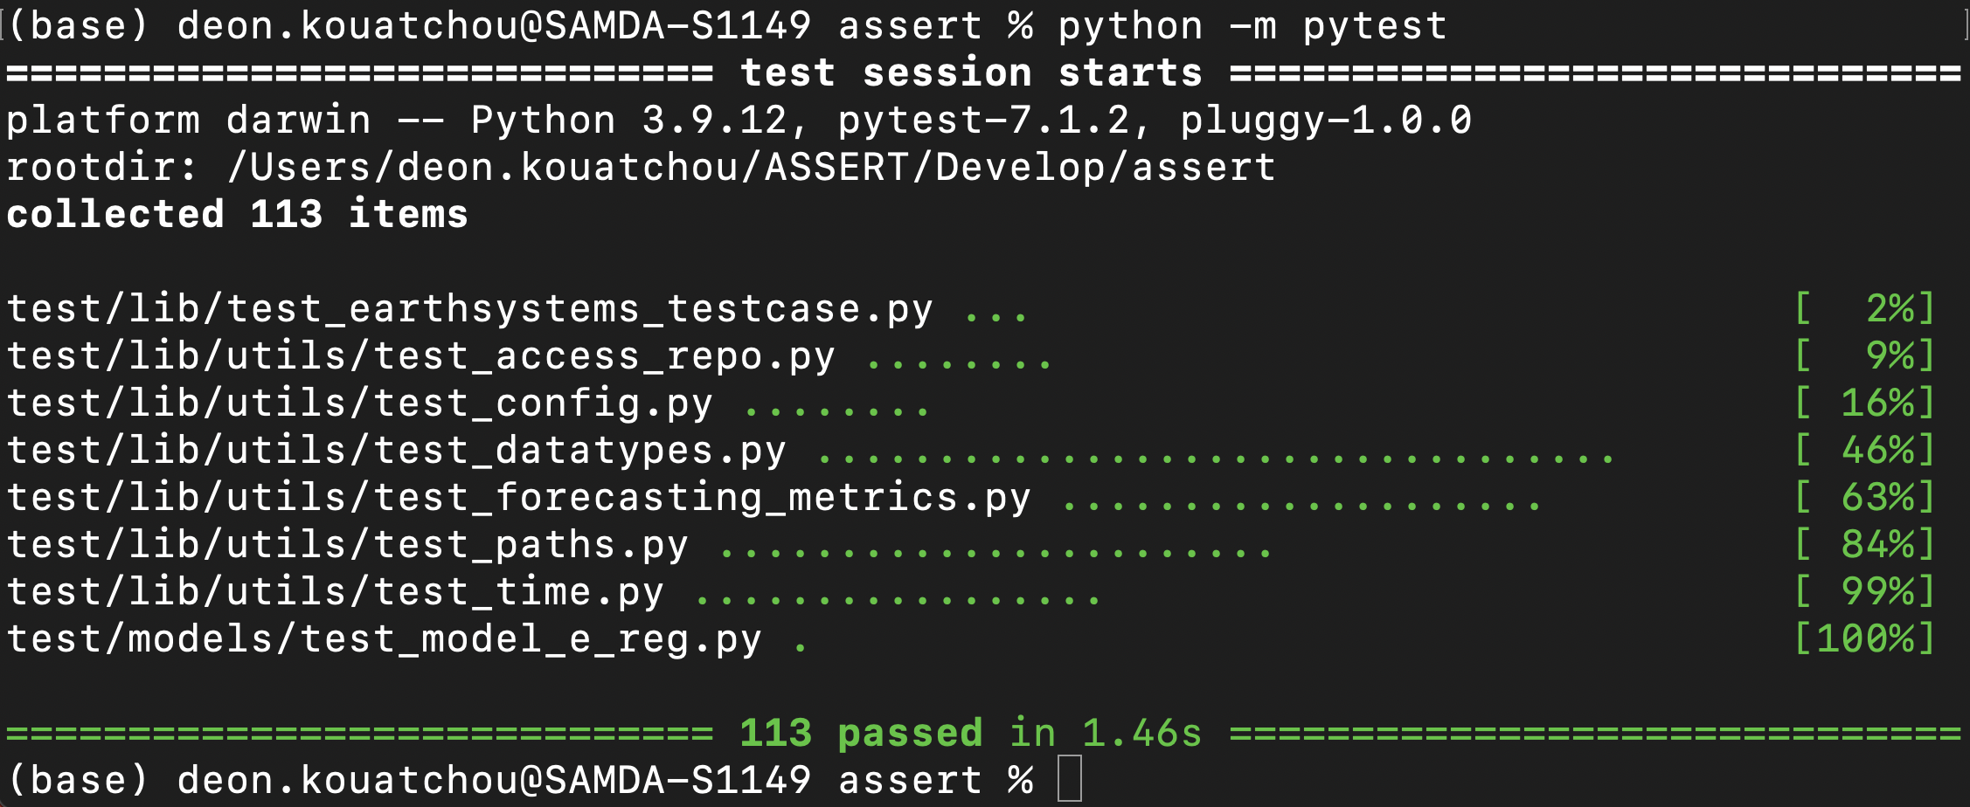
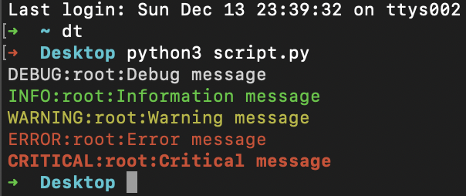
Preparation
Unit testing using PyTest
One point of emphasis for this project was increased rigor and quality of our source code.
Thus, filesystem organization, Python PEP 8 compliance, logging, and unit testing were the focus of preparation for the main part of the code.
Example of logging in Python
Source: StackOverflow
Notes:
As previously mentioned, we were looking to forge a strong foundation for the code infrastructure, meaning that source code would be held to a high standard.
Some points of preparation for this were compliance to Python's PEP 8 coding standards, consistent code documentation, rigorous unit testing, and extensive logging.

Slide 8
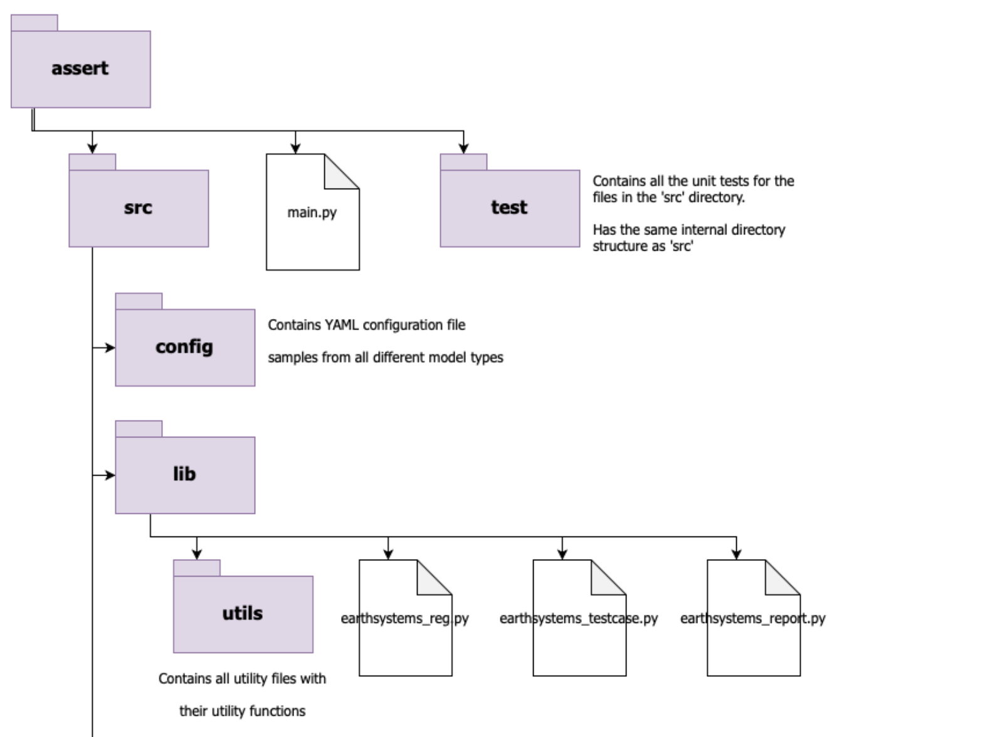
Directory Structure I
Notes:
In addition, we ensured that our directory structure was organized, designed with purpose, and compliant to Python's packaging standards.
assert: top-level directory
src: contains code to run ASSERT
main.py: main script for ASSERT
test: contains all unit testing of ASSERT itself
config: contains example YAML config files to test ASSERT
lib: contains library code
utils: contains utility files

Slide 9
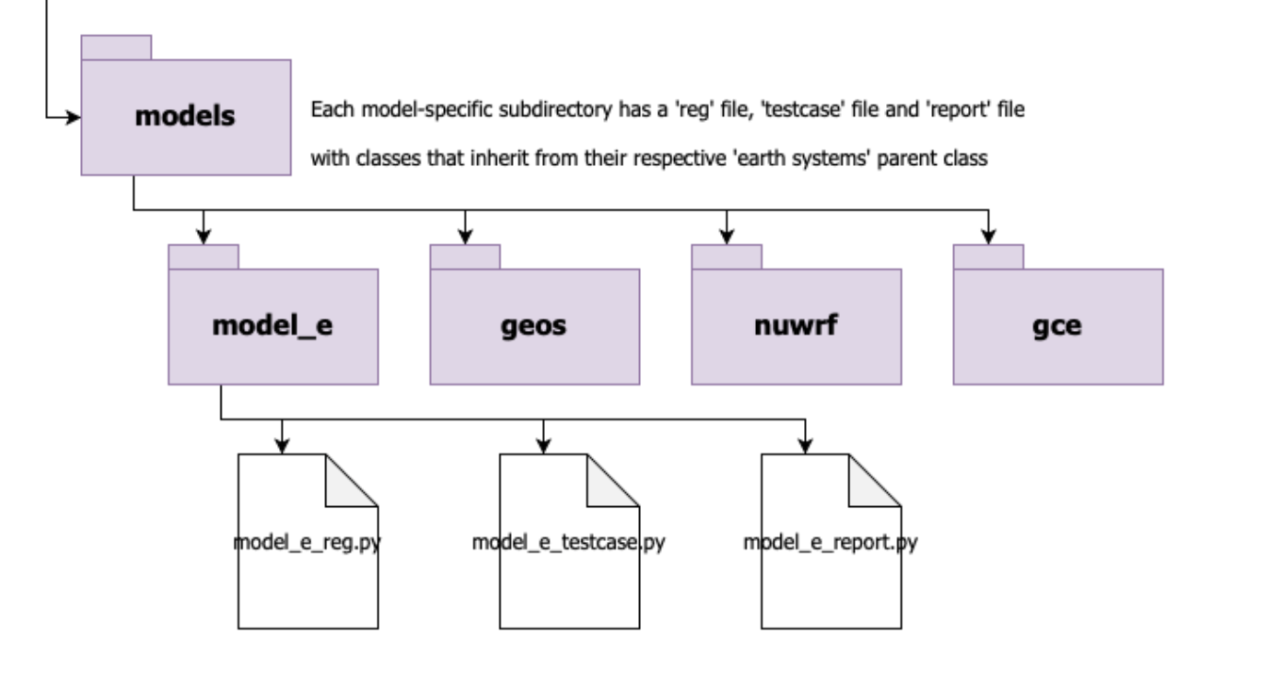
Directory Structure II
Notes:
models: contains model-specific files & classes

Slide 10
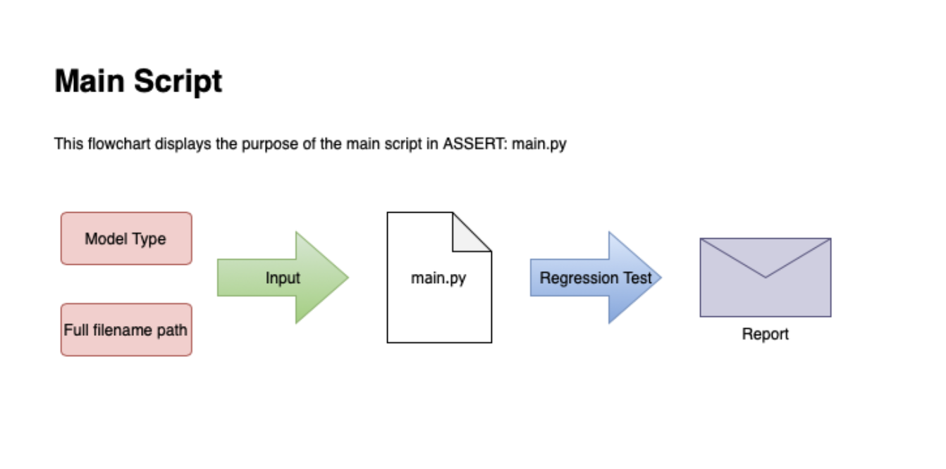
Functionality
ASSERT’s design is to input a model type and filename, run the appropriate regression test, and report the results.
The next few slides overview how I implemented this framework using inheritance and object-oriented programming.
Notes:
ASSERT is design such that the main file is run as a Python script from the command-line with two inputs: the model type, and YAML filename.
The YAML configuration file tells us everything we need to know about how to run the regression test:
- where to access the code
- how to compile it
- which tests to run
- how to run them
- where to send results
- etc.
The next few slides will focus now on the next step of the infrastructure which looks more on implementing ASSERT's functionality.

Slide 11

Infrastructure II

Slide 12
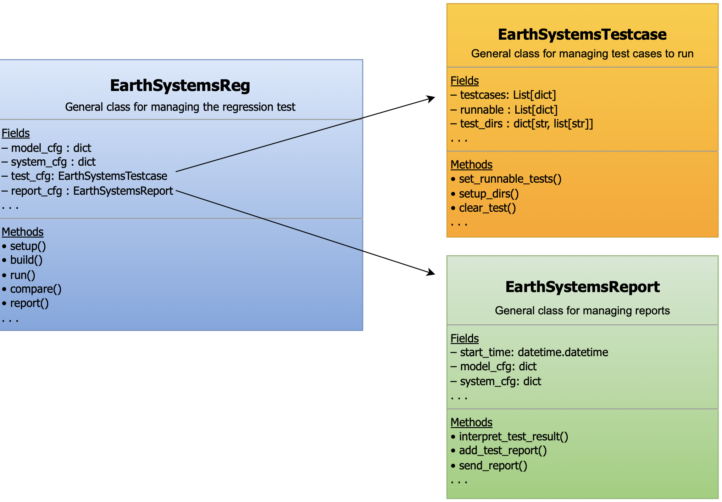
Level 1: General Classes
Notes:
There are three dominant classes currently in ASSERT:
- A 'Reg' class which manages the regression testing process as a whole
- A 'Testcase' class which manages the testing information
- and a 'Report' class which manages the reporting information
The idea is that throughout the different model types, their regression testing tools share a certain framework and behavior.
There share a classification of information found in YAML files that are often used similarly as well overall steps in the testing process which is reflected in the Fields and Methods sections in the diagram above.

Slide 13
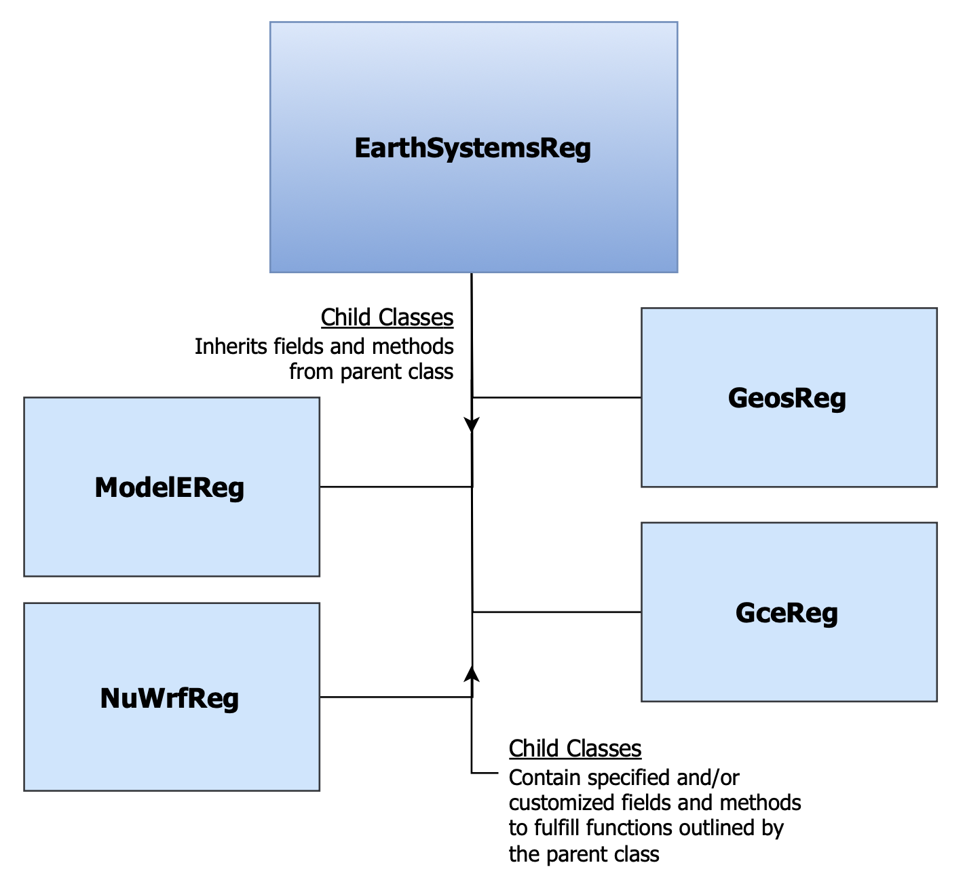
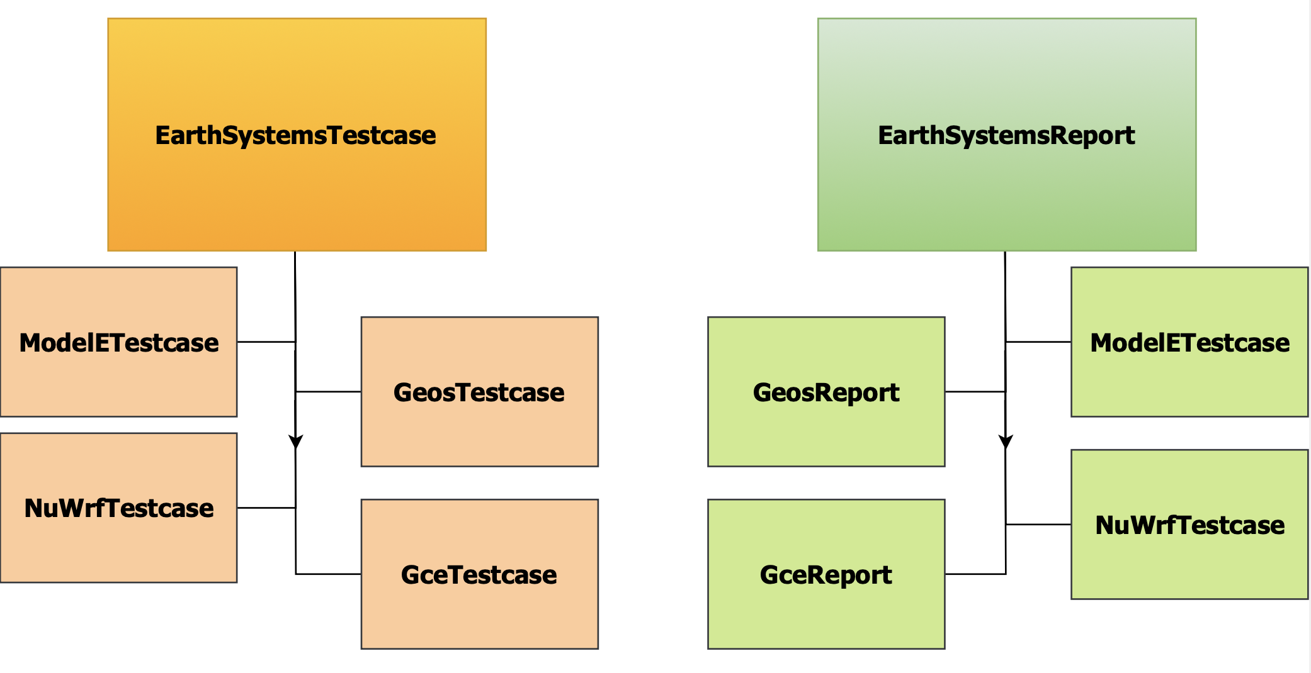
Level 2: Class Family Trees
Notes:
Thus, inheritance allows us to express this relationship in code. It allows all model-specific classes to share the general framework while tailoring the framework's implementation to their own needs.
I.e. all model types when undergoing testing will get the code, compile it, run it, compare it, and report it (outlined in general class), but the way they do those steps varies.

Slide 14
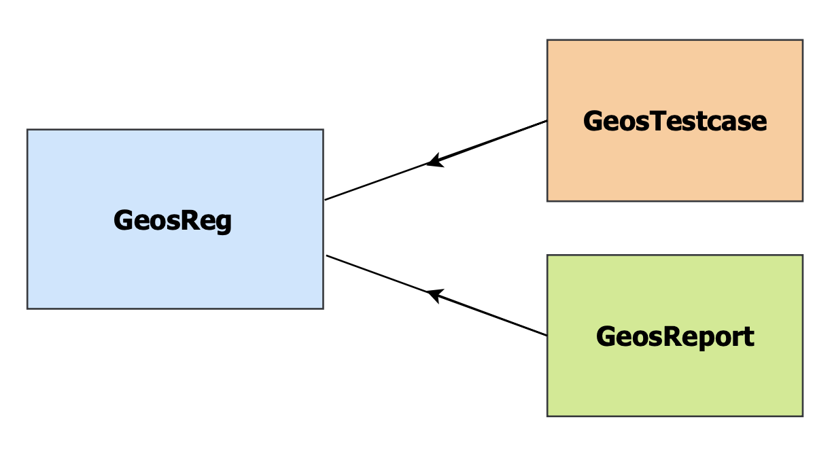
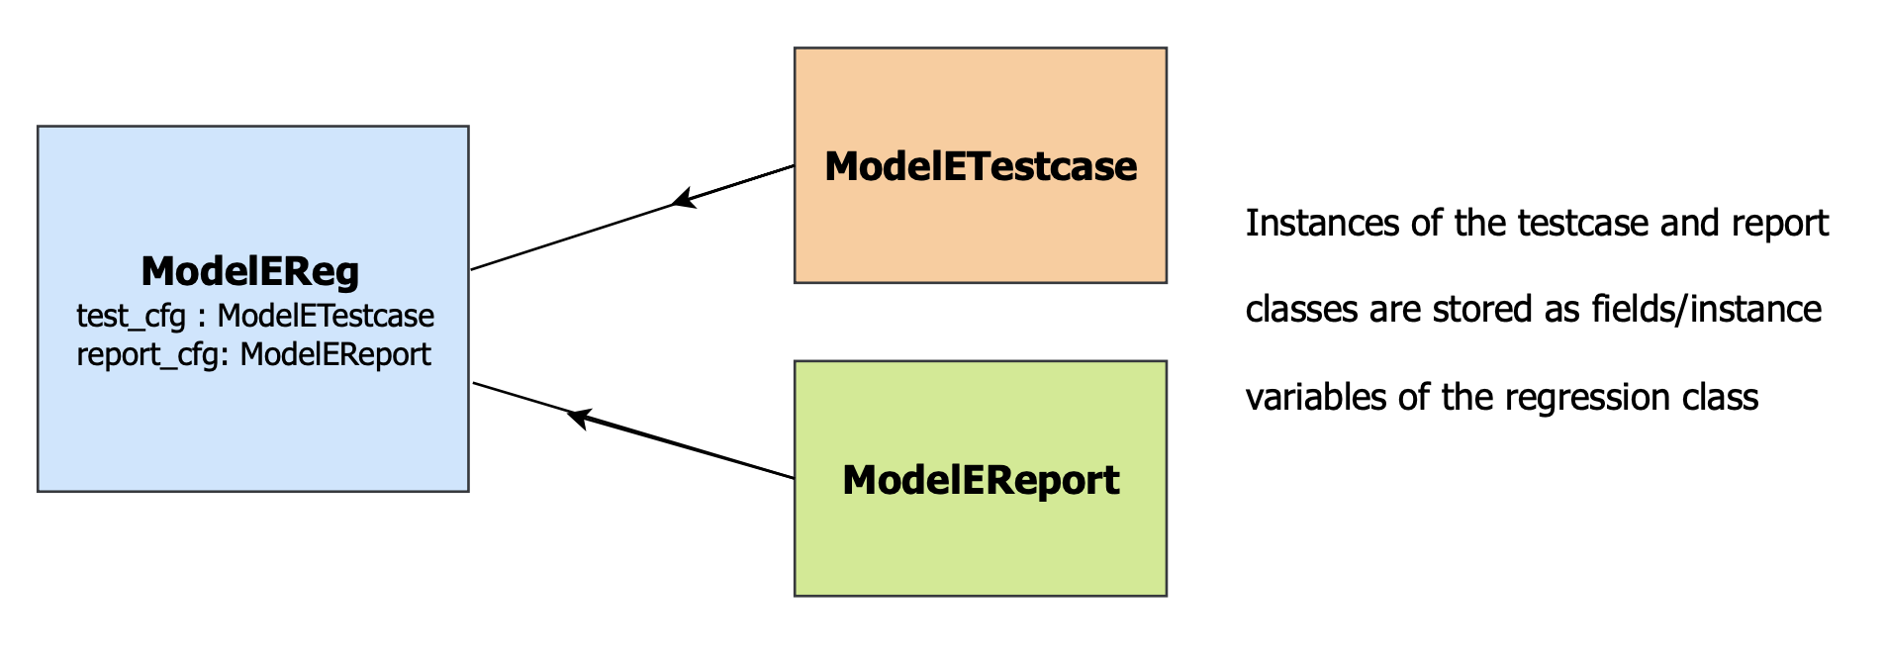
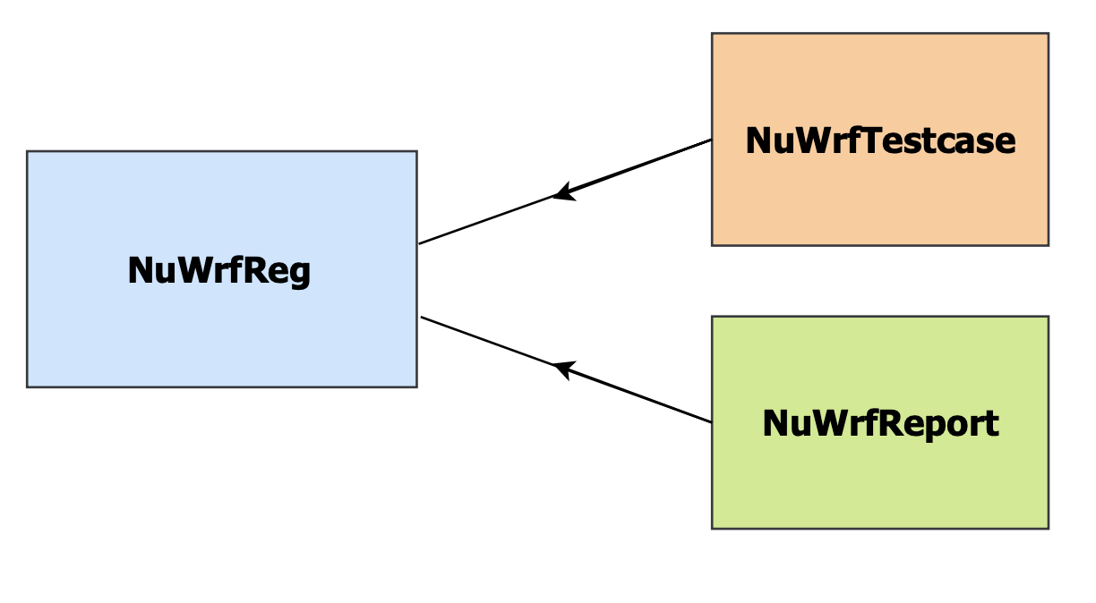
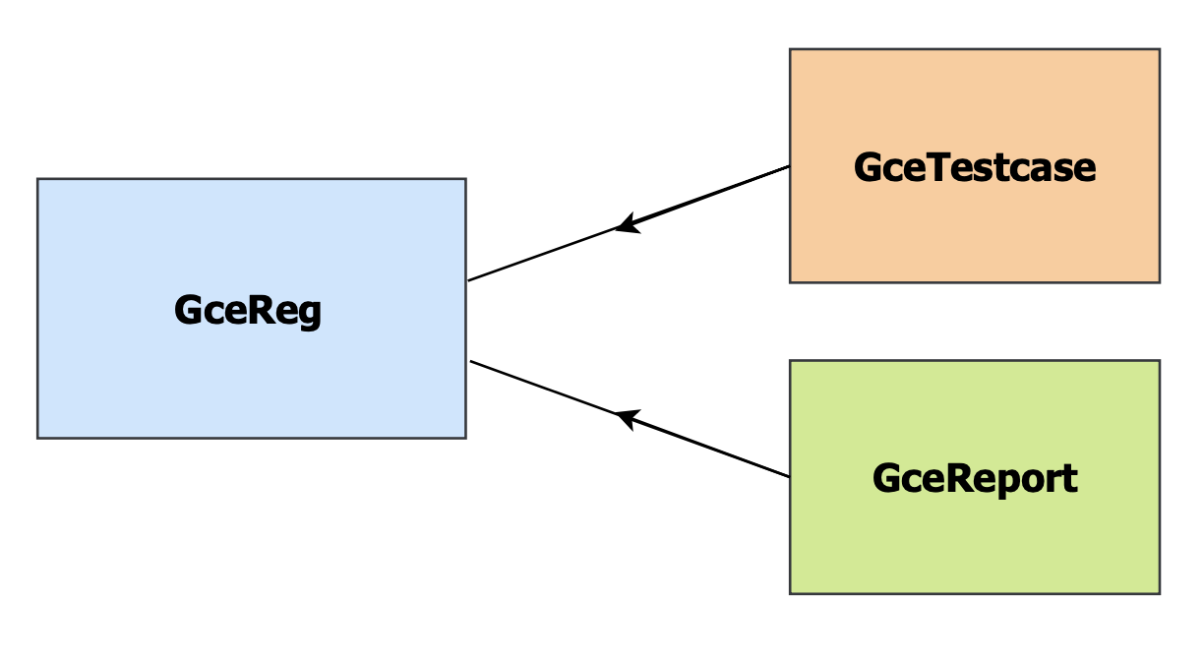
Level 3: Model-Specific Classes
Notes:
Another powerful capability of inheritance is that we can still mimic the relationship where the 'Reg' class manages regression testing for the specified model while containing instances of the model-specific 'Testcase' and 'Report' classes.

Slide 15

Demonstration
* Running template not models themselves *
Notes:
1. Show live unit testing
2. Show empty scratch directory
3. Show YAML file
4. Run ASSERT
5. Show scratch directory aftermath
6. Show email report

Slide 16

Conclusion

Slide 17





Next StePs
Full integration of earth-systems models into ASSERT:
Writing regression testing code in the current infrastructure
Writing integration tests for all the added models
Writing utility functions and files to the infrastructure as needed
Adjustment of logging as needed
Formatting of email report
Notes:
As previously stated, only the infrastructure has been implemented. The difficult part is now full integration of the regression testing tools into ASSERT.
This includes the
- testing code itself
- integration tests for the new tools that will go in the 'test' directory
- more utility functions and tests for those
Logging is currently functional but not heavily reviewed, so they can always be adjusted as necessary.
Creating a more robust report email.

Slide 18

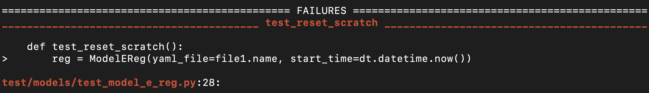
Challenges
Keeping track of all the inheritance occurring
Maintaining balance between generality and specificity in the code design
Creating adequate unit testing for complex utility functions
Notes:
There are a lot of classes and a lot of inheritance. This can make incorporating new features tricky as their location must be considered.
This relates directly to maintaining the balance between generality and specificity with the code infrastructure.
There are currently 8 utility files each which many utility functions. Writing rigorous, adequate unit tests can be time-consuming and difficult.
For example, forecasting_metrics does a lot of error calculations which can be off in unit testing due to Python's calculation procedures.

Slide 19



References and Acknowledgements
Mentors and Colleagues:
Carlos Cruz
Jules Kouatchou
Bruce Van Aartsen
Helpful Websites:
GeeksforGeeks
RealPython
StackOverflow
Python Documentation
Notes:
Would like to thank mentors and colleagues for their guidance, communication, and vision for the project.
Websites that were very helpful for understanding many new Python modules as well as for troubleshooting.

Slide 20
Thank You

